Slide 1
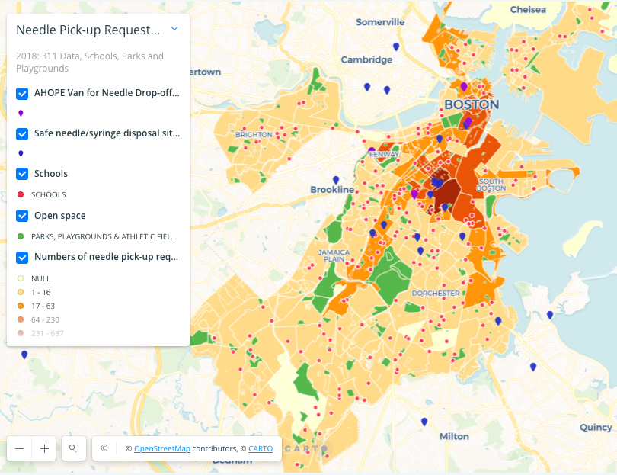
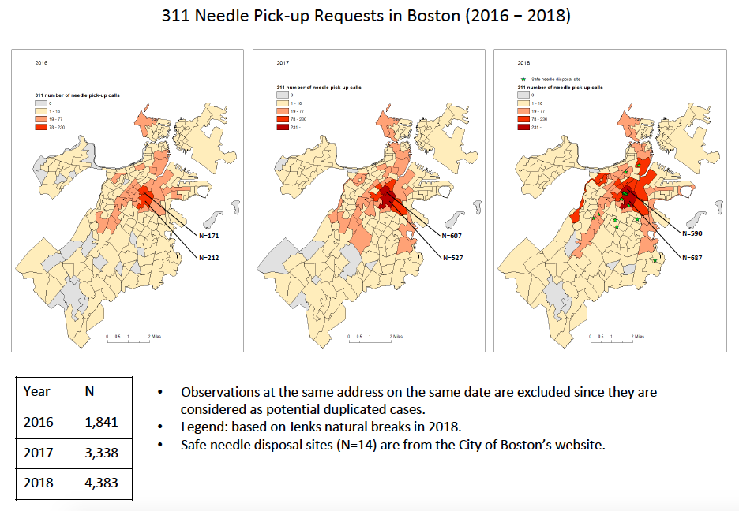
Community Housing Data Tool: Needle Safety
Soojin Conover & Hailun Wang
Vital Village at Boston Medical Center
WHO WE ARE
DATA STORY
CONCLUSIONS
Vital Village is a network of residents and organizations committed to maximizing child, family, and community well-being. Our place-based, community engagement network mobilizes collective investment from residents, community organizations and institutions to seed scalable and sustainable community change around child protection and promoting healthy social and emotional development in early childhood.
We align preventive efforts across sectors to enhance existing services for children. This approach is sustainable because we embed community-driven preventive strategies in the context of existing systems for child health and education and community development. We strive to connect and strengthen opportunity structures that support protective factors and family strengths within existing community resources. We couple community-based participatory research and improvement science methodology to drive progress.
[2018 Distribution of Needle Pick-up Requests & Schools in the City of Boston, MA]
This is a part of Vital Village’s Community Housing Data Tool aiming to provide data and resource maps intended for individuals, families, and organizations interested in learning more about the state of housing environments in our Boston community.
These data maps illustrate a critical community safety issue particularly for children since they can be pricked by discarded needles in playgrounds, parks, near school during recess or on the sidewalk outside their home. (The data map shows school locations, safe needle disposal sites in the city.)
If you visit our community housing data tool, you will be able to see your location on this map by entering your address.
(http://bit.ly/housingtool)
The number of BOS:311 needle pick-up request calls has been increasing over the past few years (from about 1,800 reports in 2016 to over 4,600 reports in 2018).
Since these are the numbers of needle pick-up requests reported to the city, the actual numbers of discarded needles may be substantially higher than the numbers illustrated in the data maps.
Discarded needles in playgrounds, parks, near school during recess or on the sidewalk outside children’s home is a serious health and safety issue.
More safe needle disposal sites are required.
Voices of parents need to be heard by the city. Collaboration among the city, schools, community organizations, and parents is required to address the issue.
Boston residents or community organizations are welcome to use the data maps for advocacy work or community discussion.
FUTURE DIRECTIONS
Vital Village will continue to co-develop data tools with our community that could be informative to Boston families and useful to advocacy work.
BACKGROUND
Local news articles have reported that discarded needles in the Boston community is a serious safety and health risk, caused by the ongoing opioid epidemic:
Acknowledgements
Community Housing Data Tool is the product of Vital Village Network’s Community Data Workgroup: a team of diverse individual and organizational community partners who are all interested in supporting Boston families in obtaining safe, affordable, high quality housing.
References
Data source: City of Boston (2019). Analyze Boston: 311 Service Requests.
Contact Information
Soojin Conover: soojin.conover@bmc.org
Website: https://www.vitalvillage.org/
“Boston collected more than 1 million used syringes in two years.”
“Tired of stepping over needles near school, students say enough.”
“Parents fed up with ongoing discarded needle threat at Roxbury playground.”
“Two girls stuck by used needle while playing during after-school program.”
Notes:
Single sided poster!

